Slide 1
Figure 1 (a) Map showing location of three large river basins (grey) and the field transects (red). (b) Upper Mississippi River transect August 2015 (c) Lower Amazon River (TROCAS) cruises conducted on February 2016, November 2016 and April 2017 (d) Lower Columbia River Cruise

Slide 2
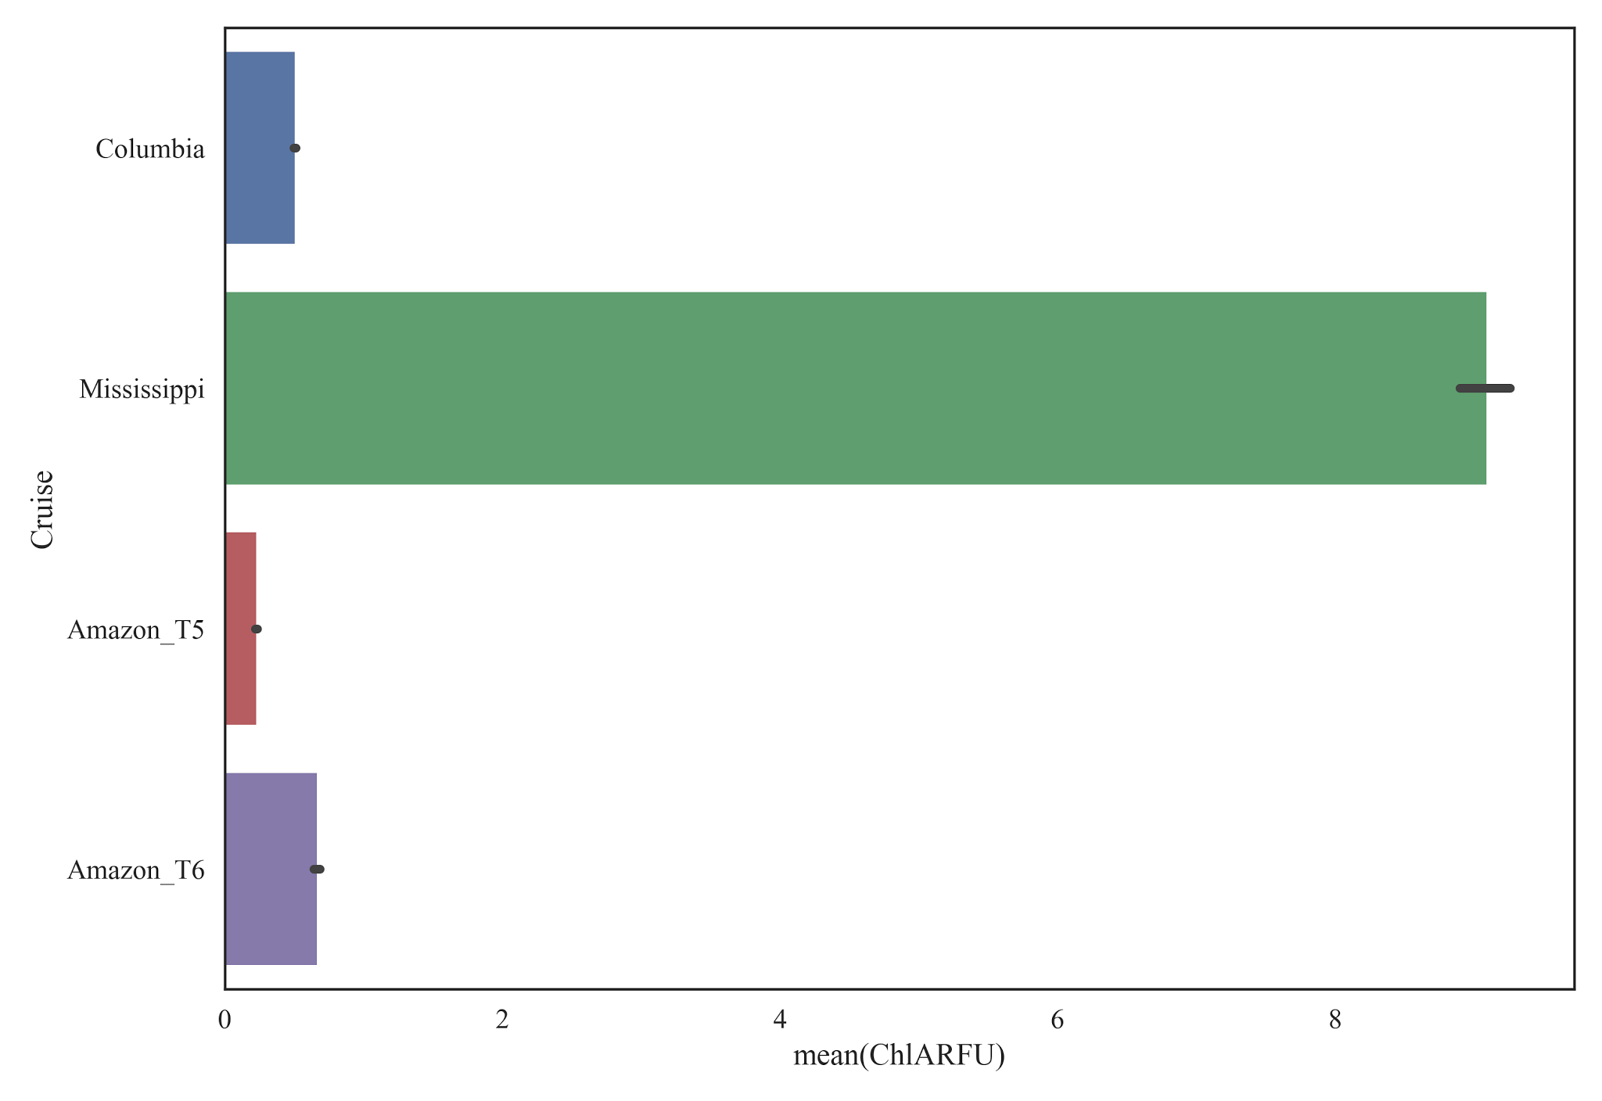
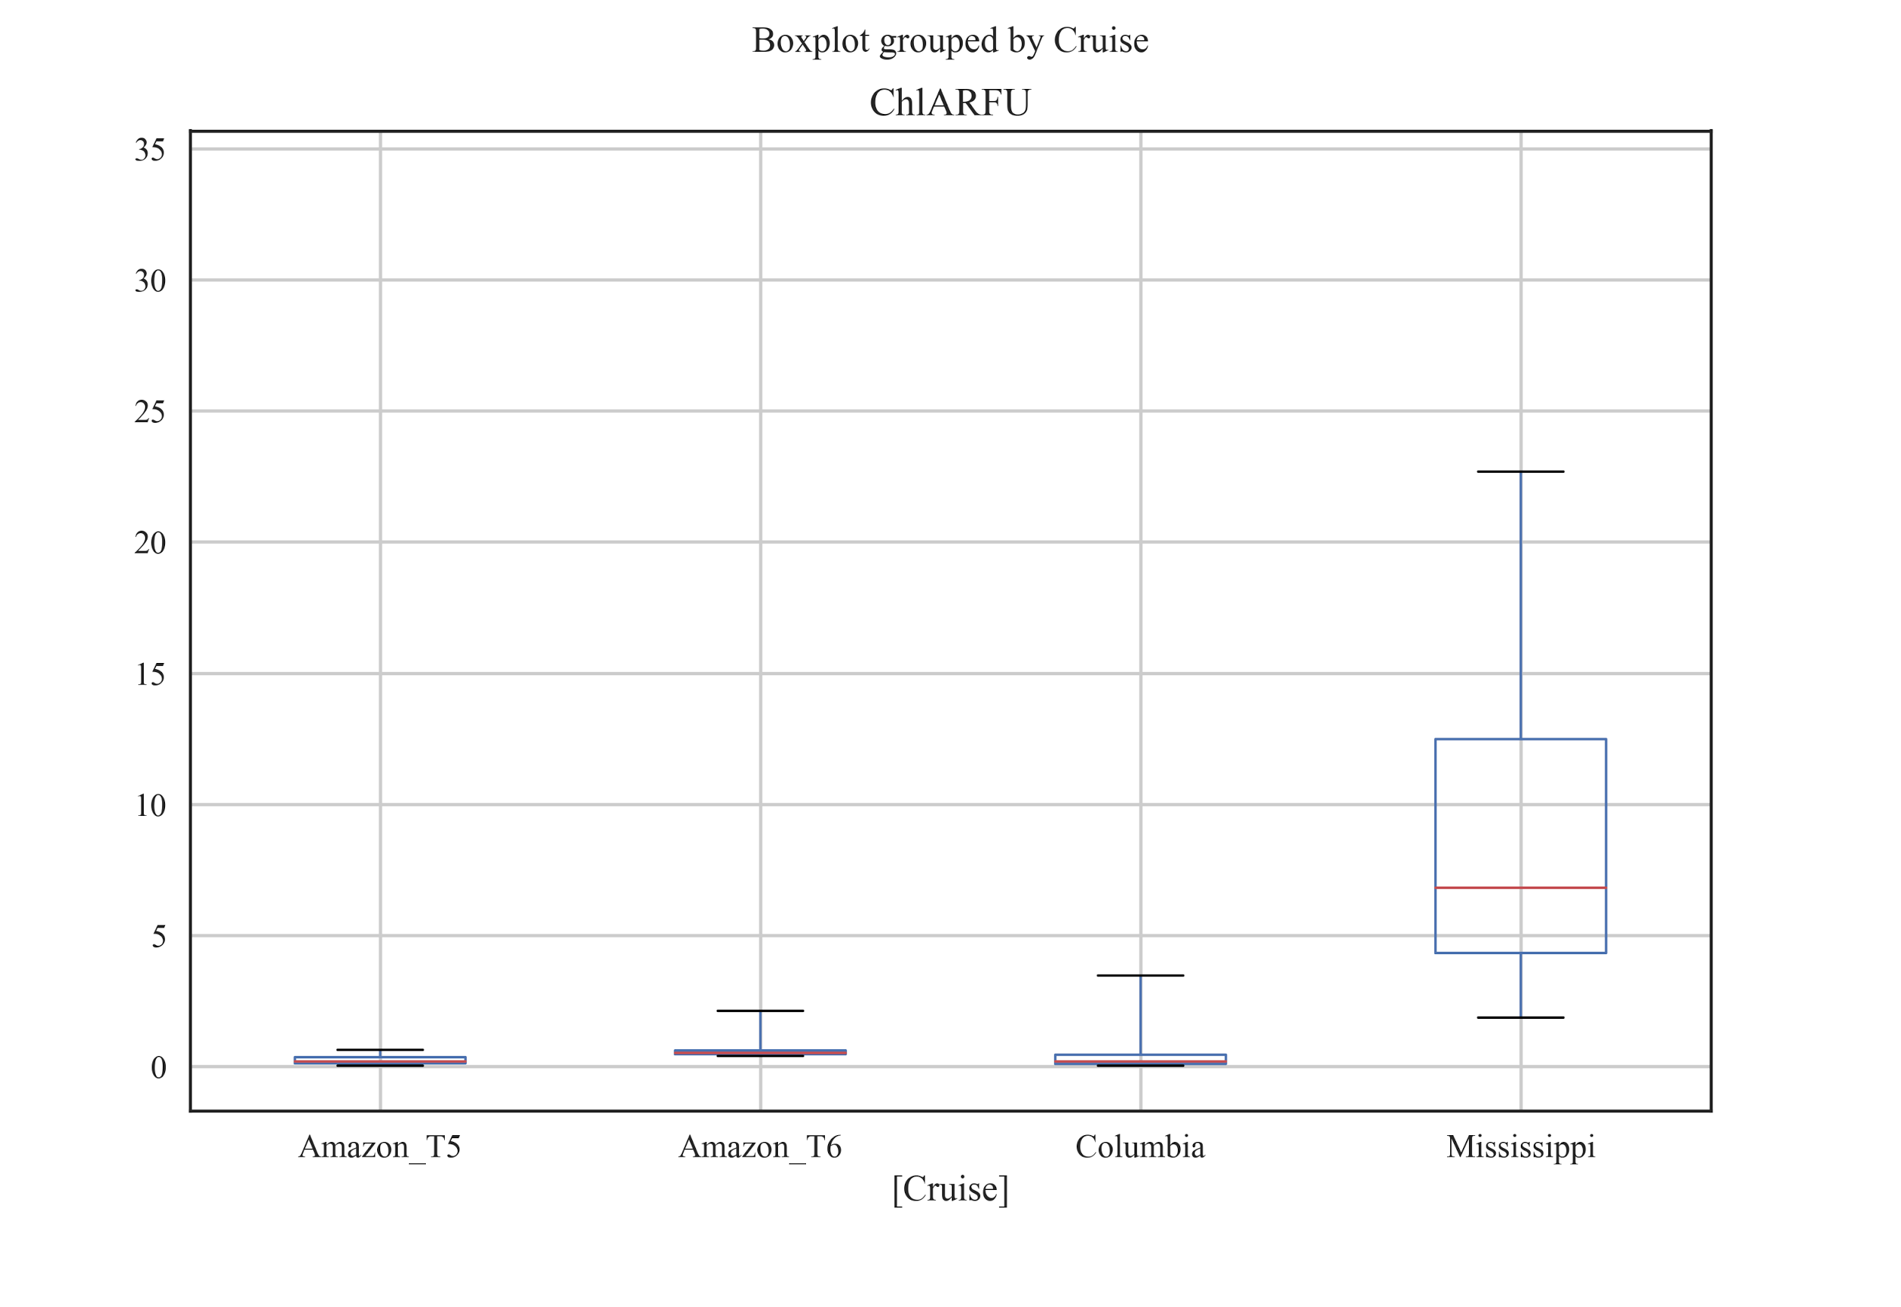

Slide 3
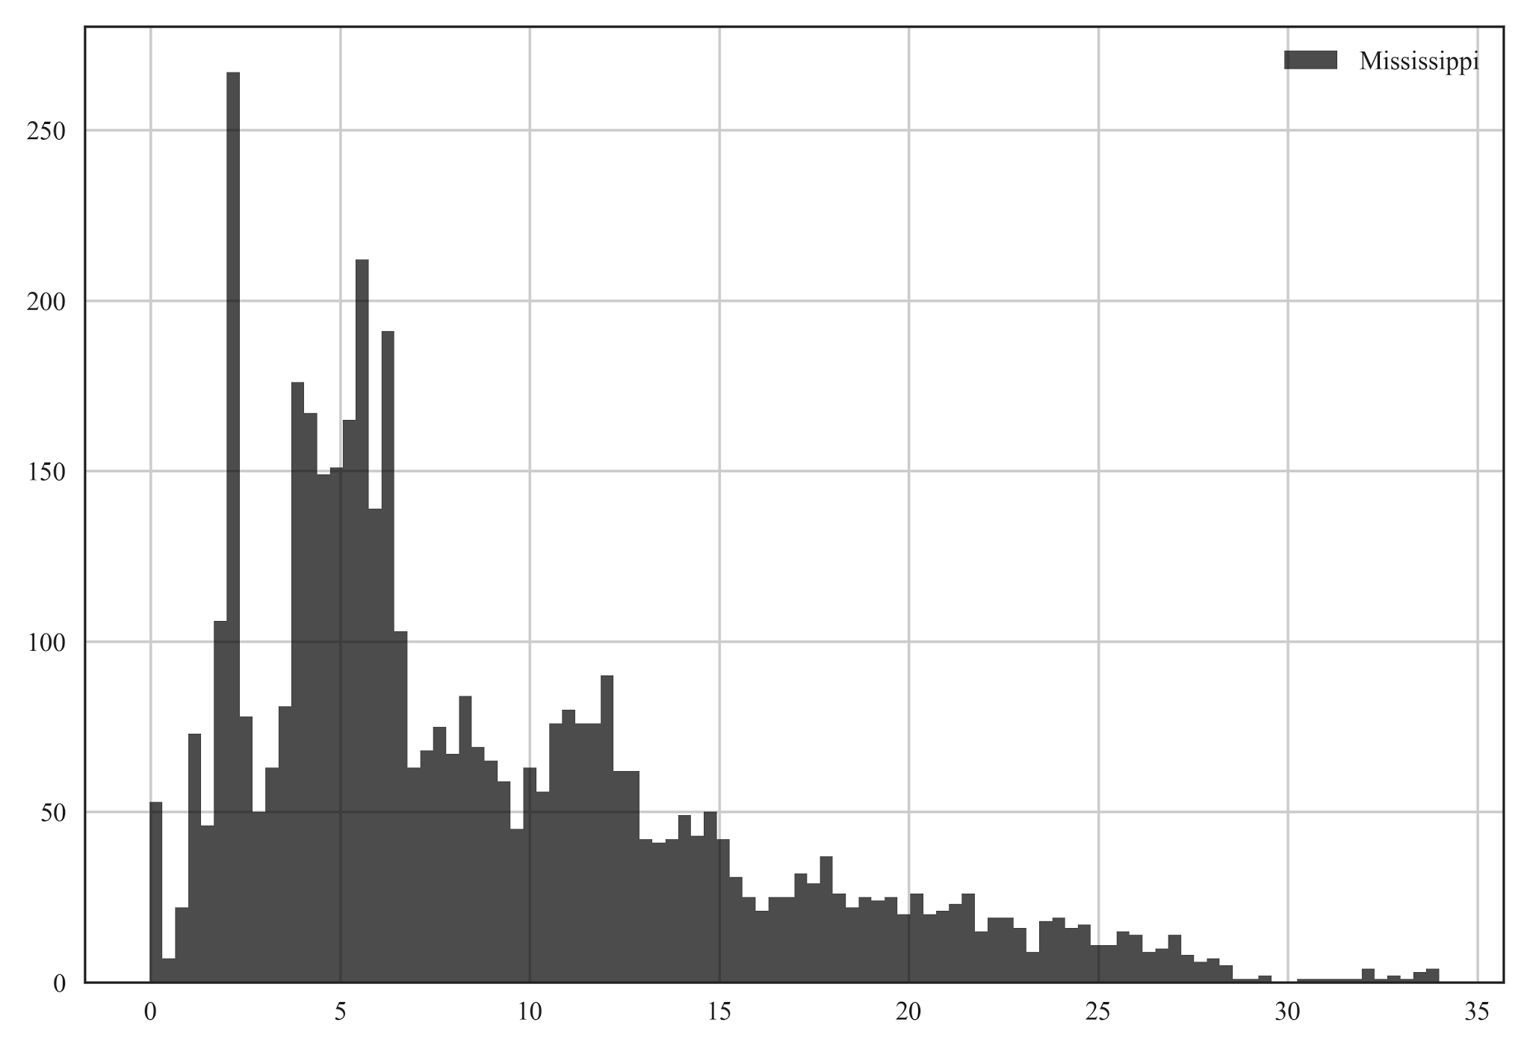
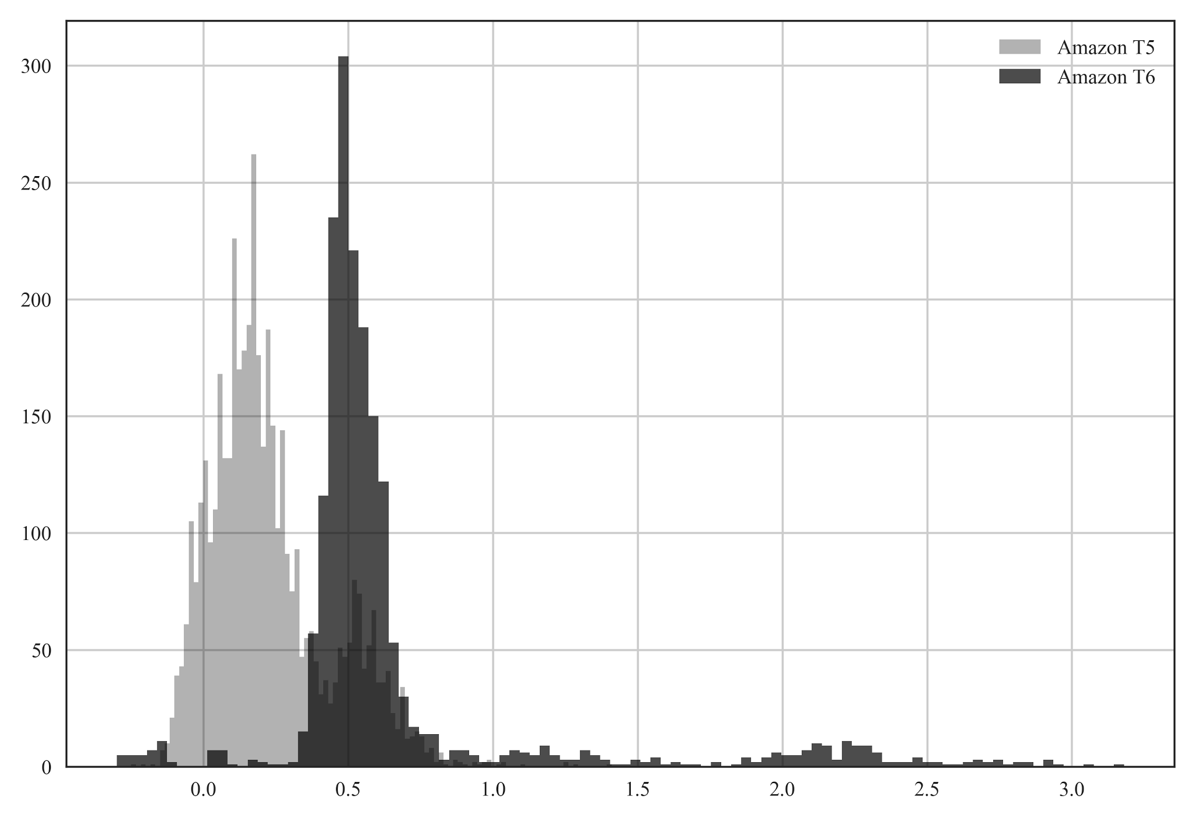
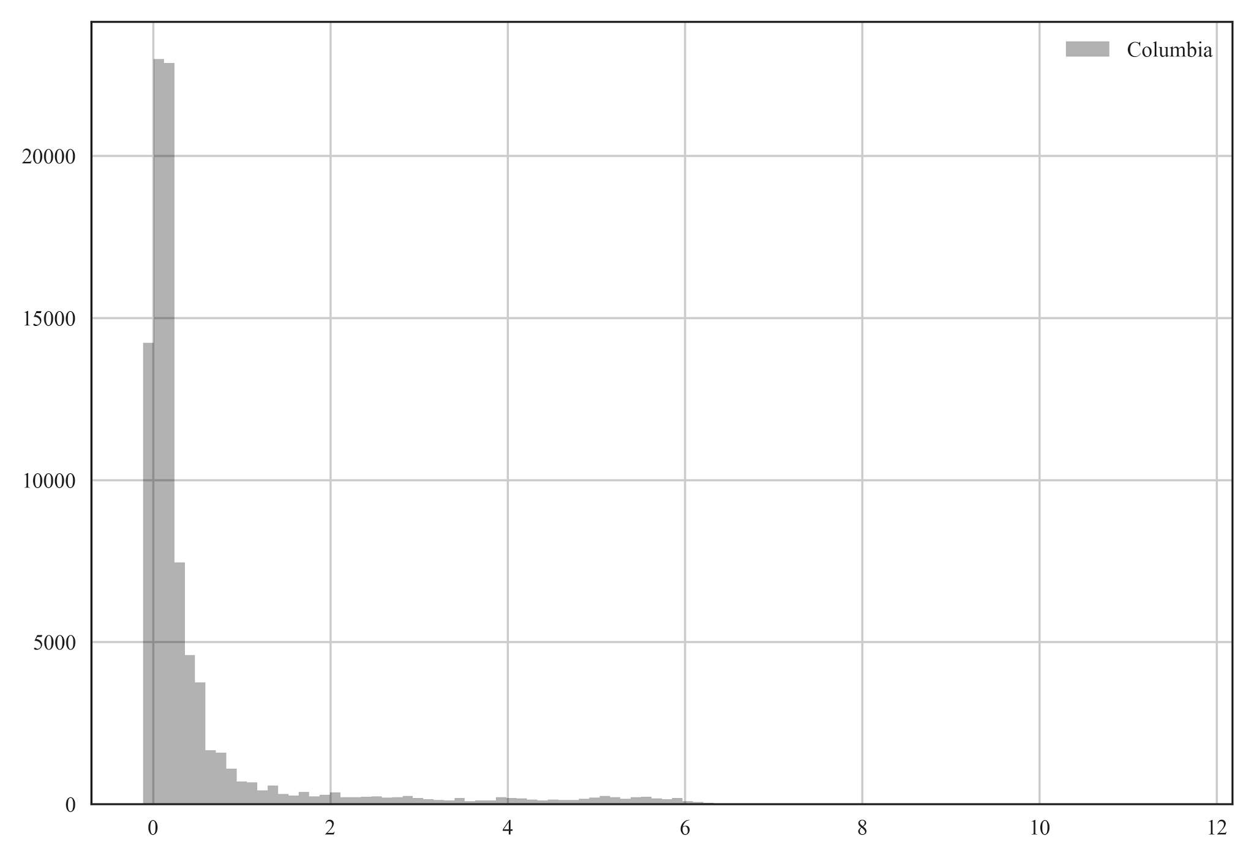
HIstograms showing distribution of Chlorophyll A (RFU) as measured in the field by YSI EXO-2 sondes for the Columbia (top), Missisippi (middle) and Amazon (bottom). Note the change in the x-axis

Slide 4
Time series plots from each of the cruises for pH, turbidity, FDOM and chlorophyll-a

Slide 5
Time series plots from each of the cruises for dissolved methane (where available) and carbon dioxide.

Slide 6
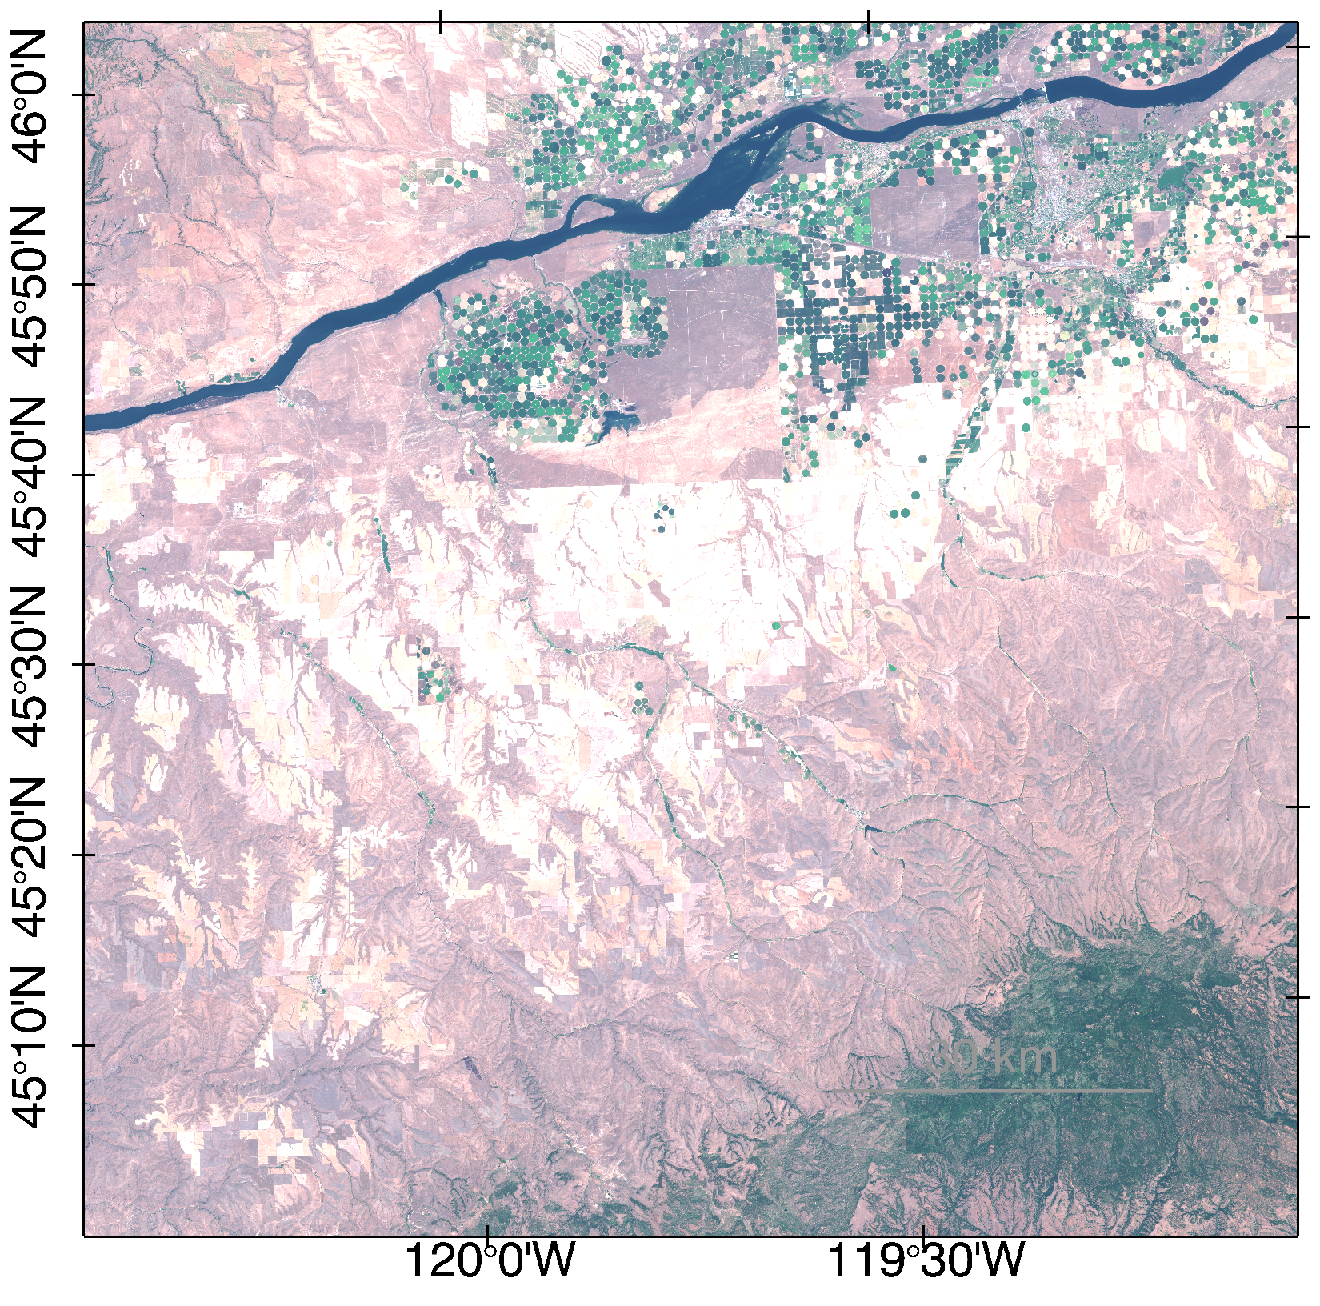
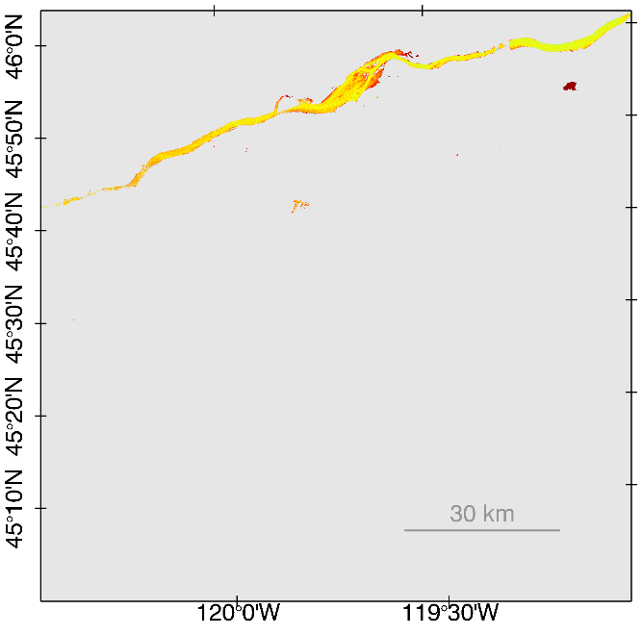
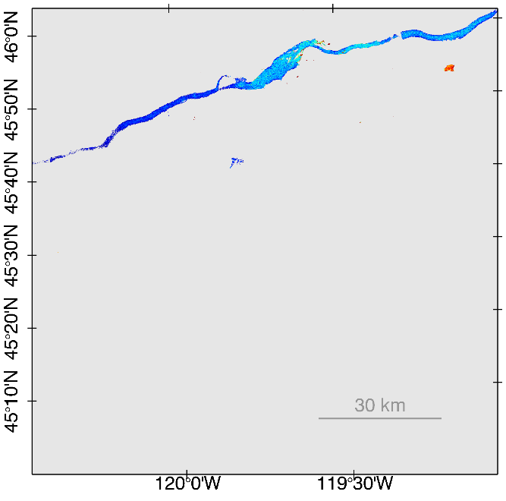
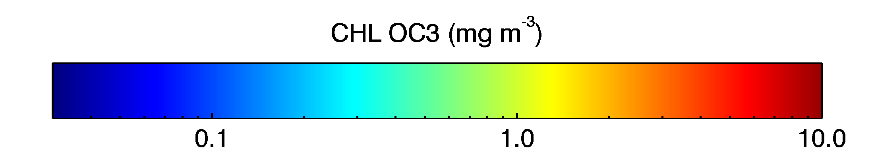
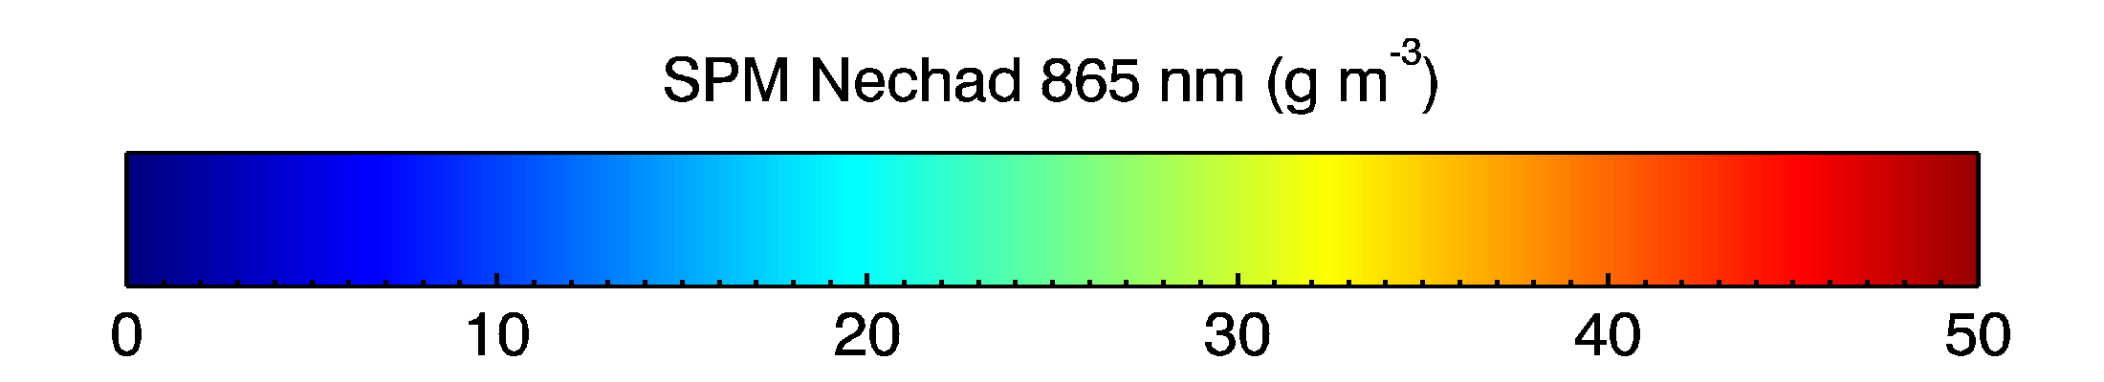
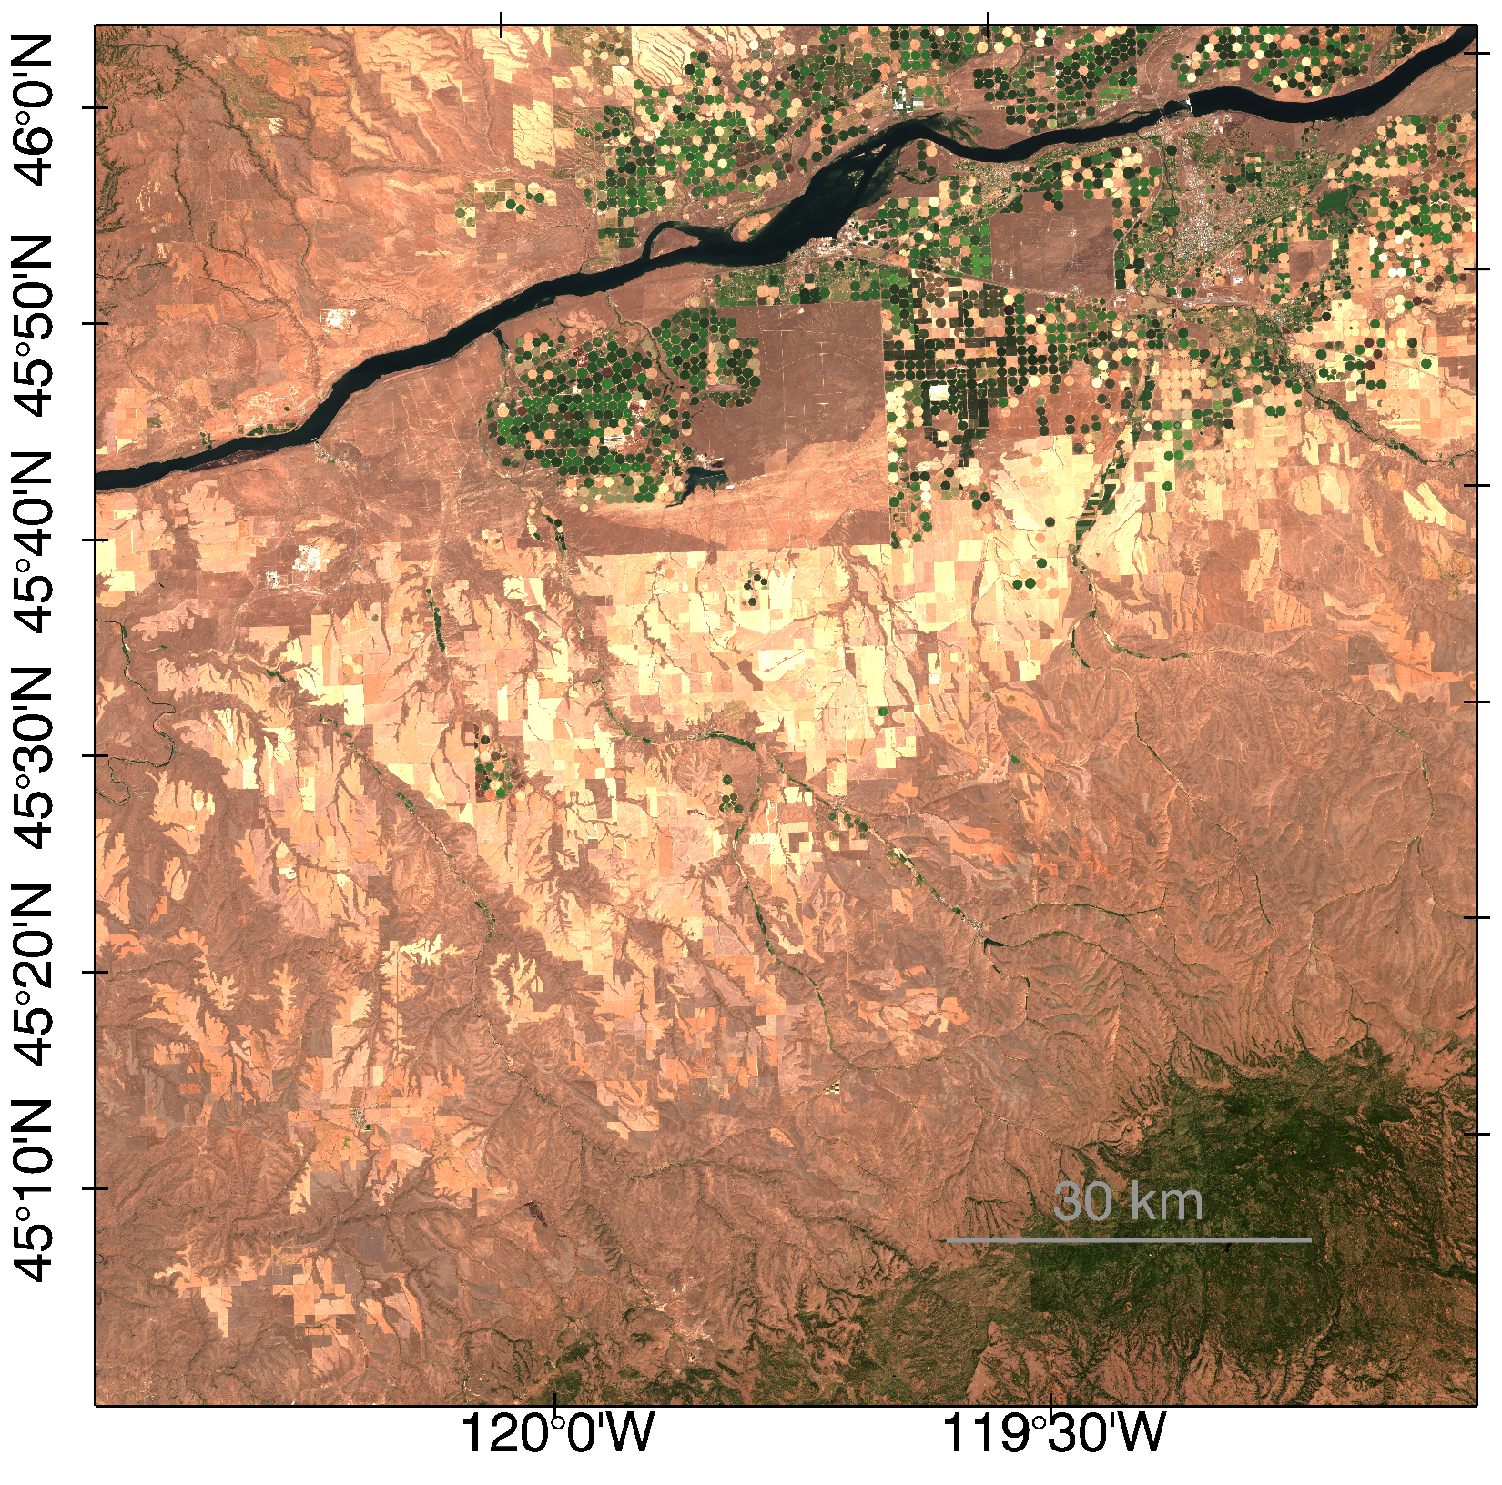
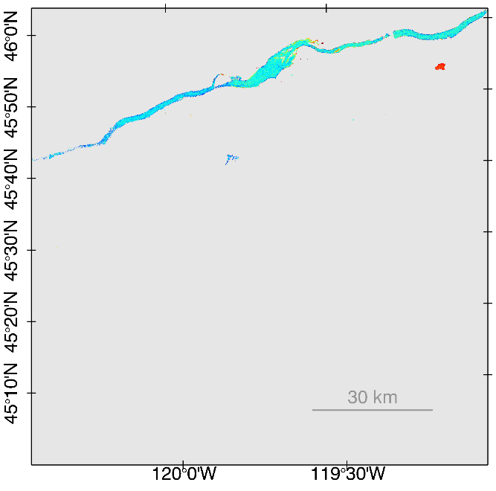
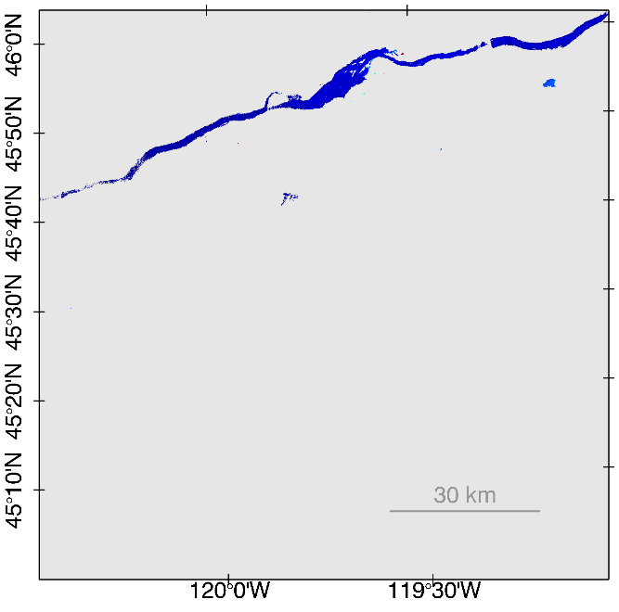
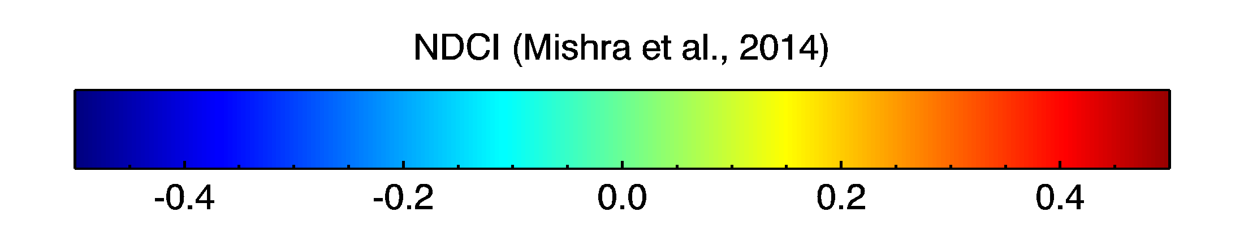
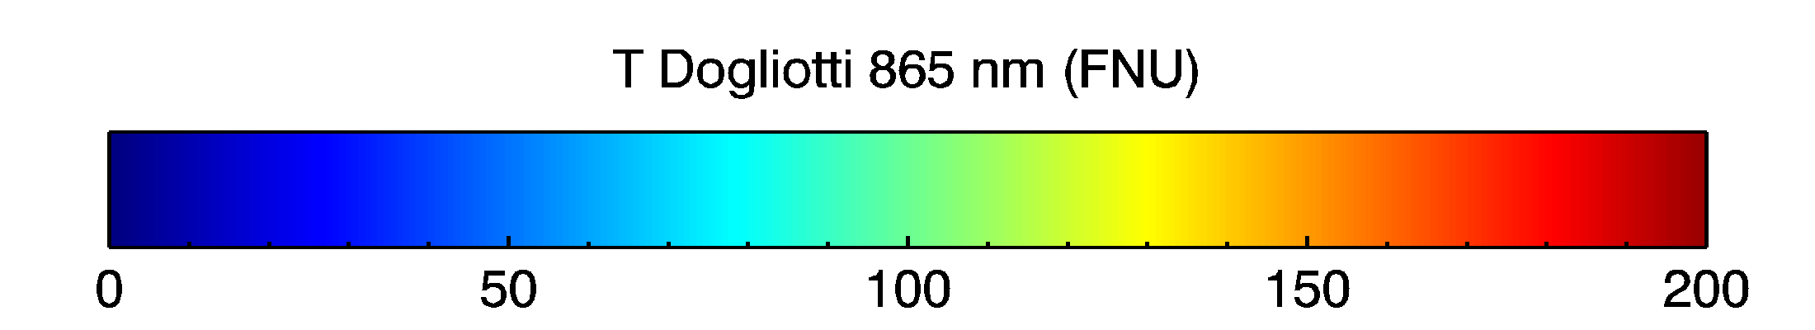
a
c
e
Sentinel 2 MSI (a) top-of-the-atmosphere and (b) Rayleigh-corrected images for the Columbia River acquired on July 13th, 2016 over Lake Wallula and Umatilla. Retrieved constituents includes (c) chlorophyll-a (mg/m3) using a blue-green band ratio algorithms (OC3), (d) a normalized chlorophyll-a index using the red and red edge bands (e) suspended particulate matter and (f) turbidity both derived using the near infrared.
b
d
f

Slide 7
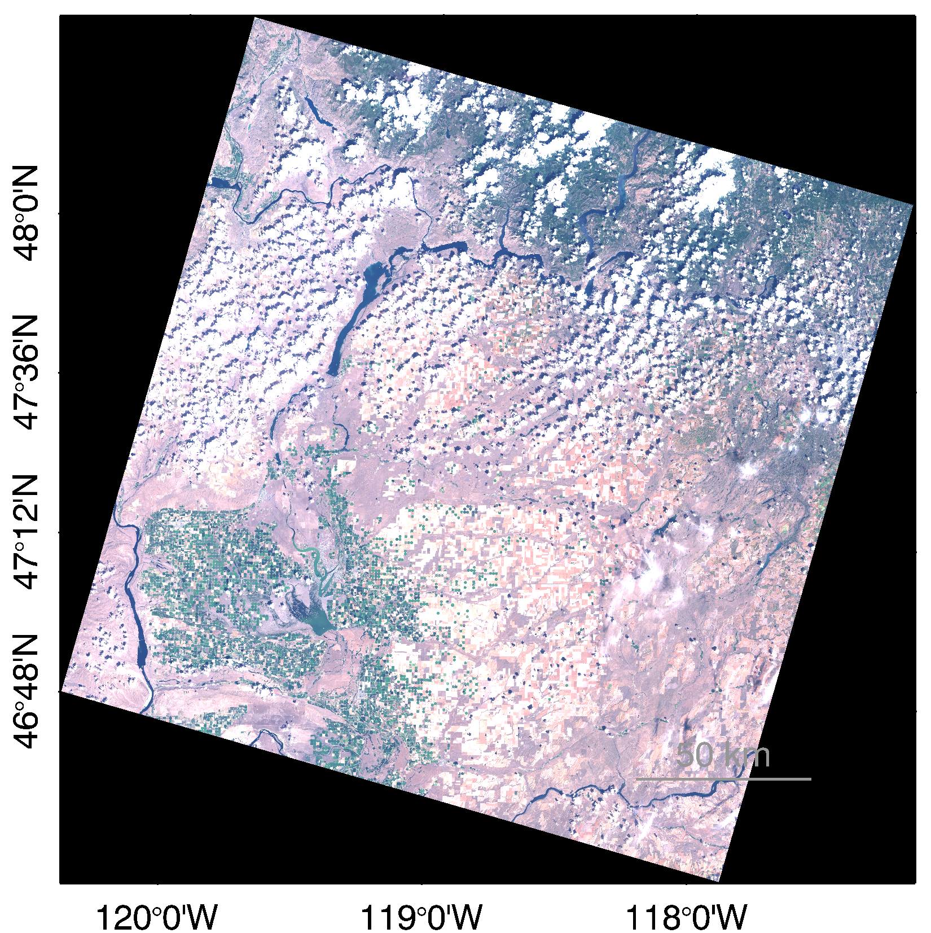
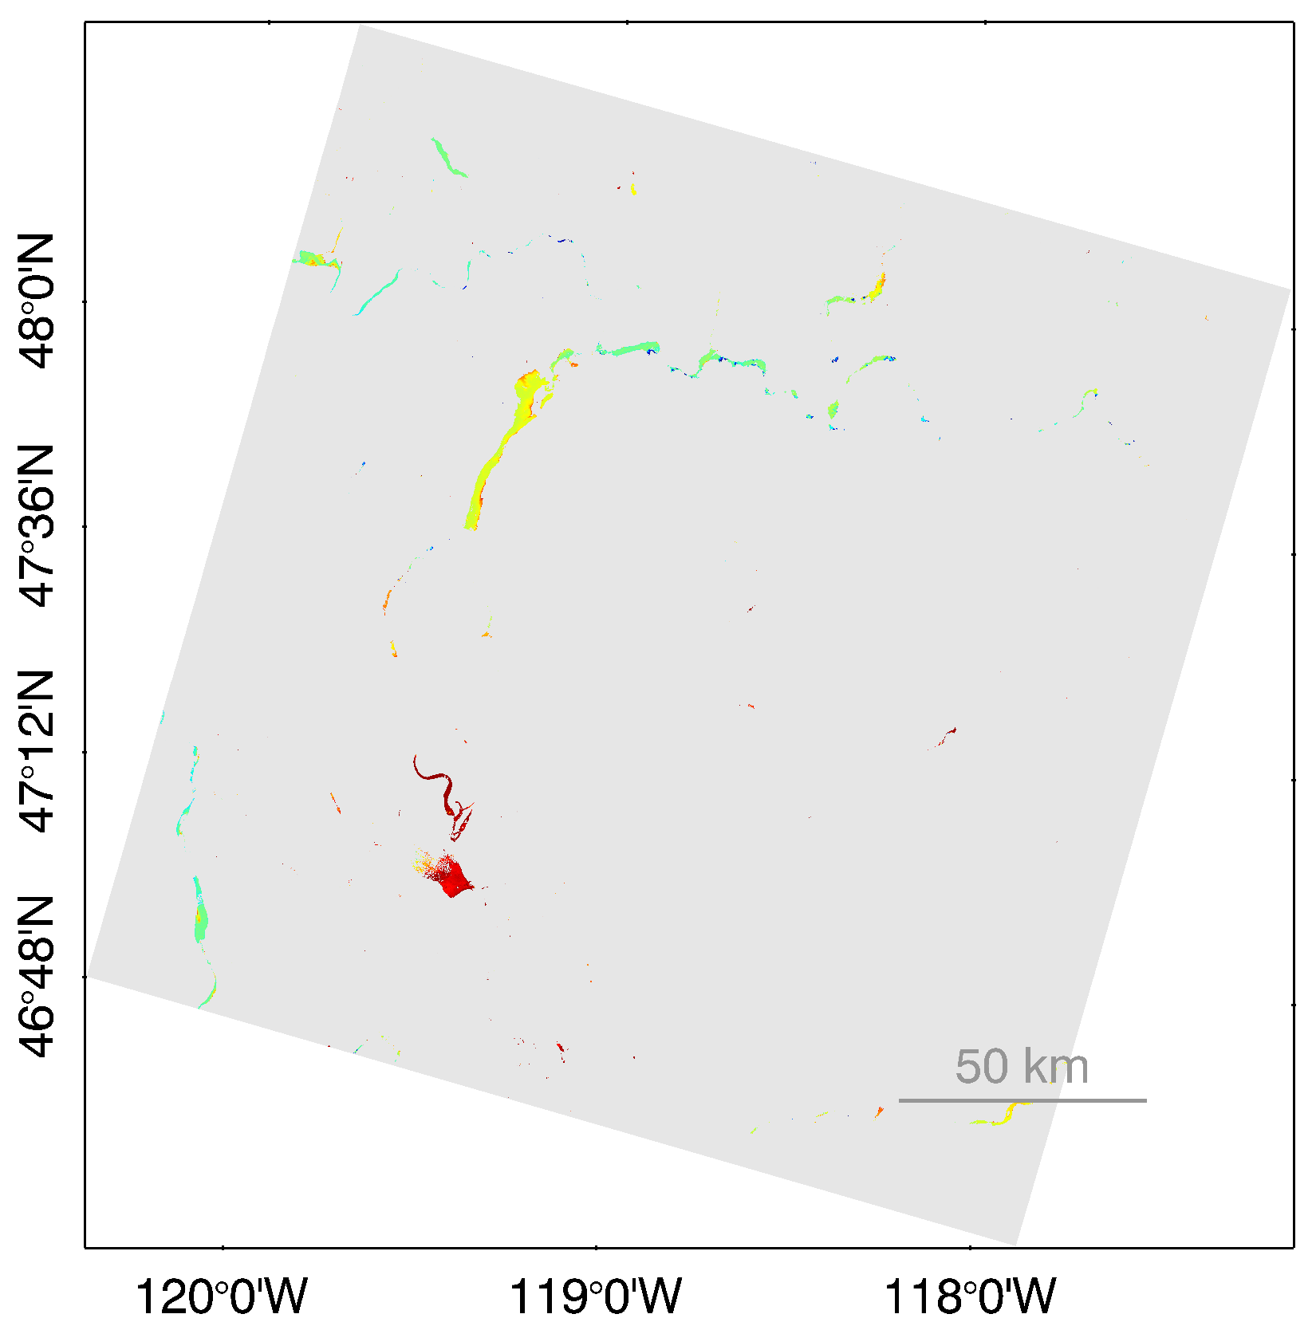
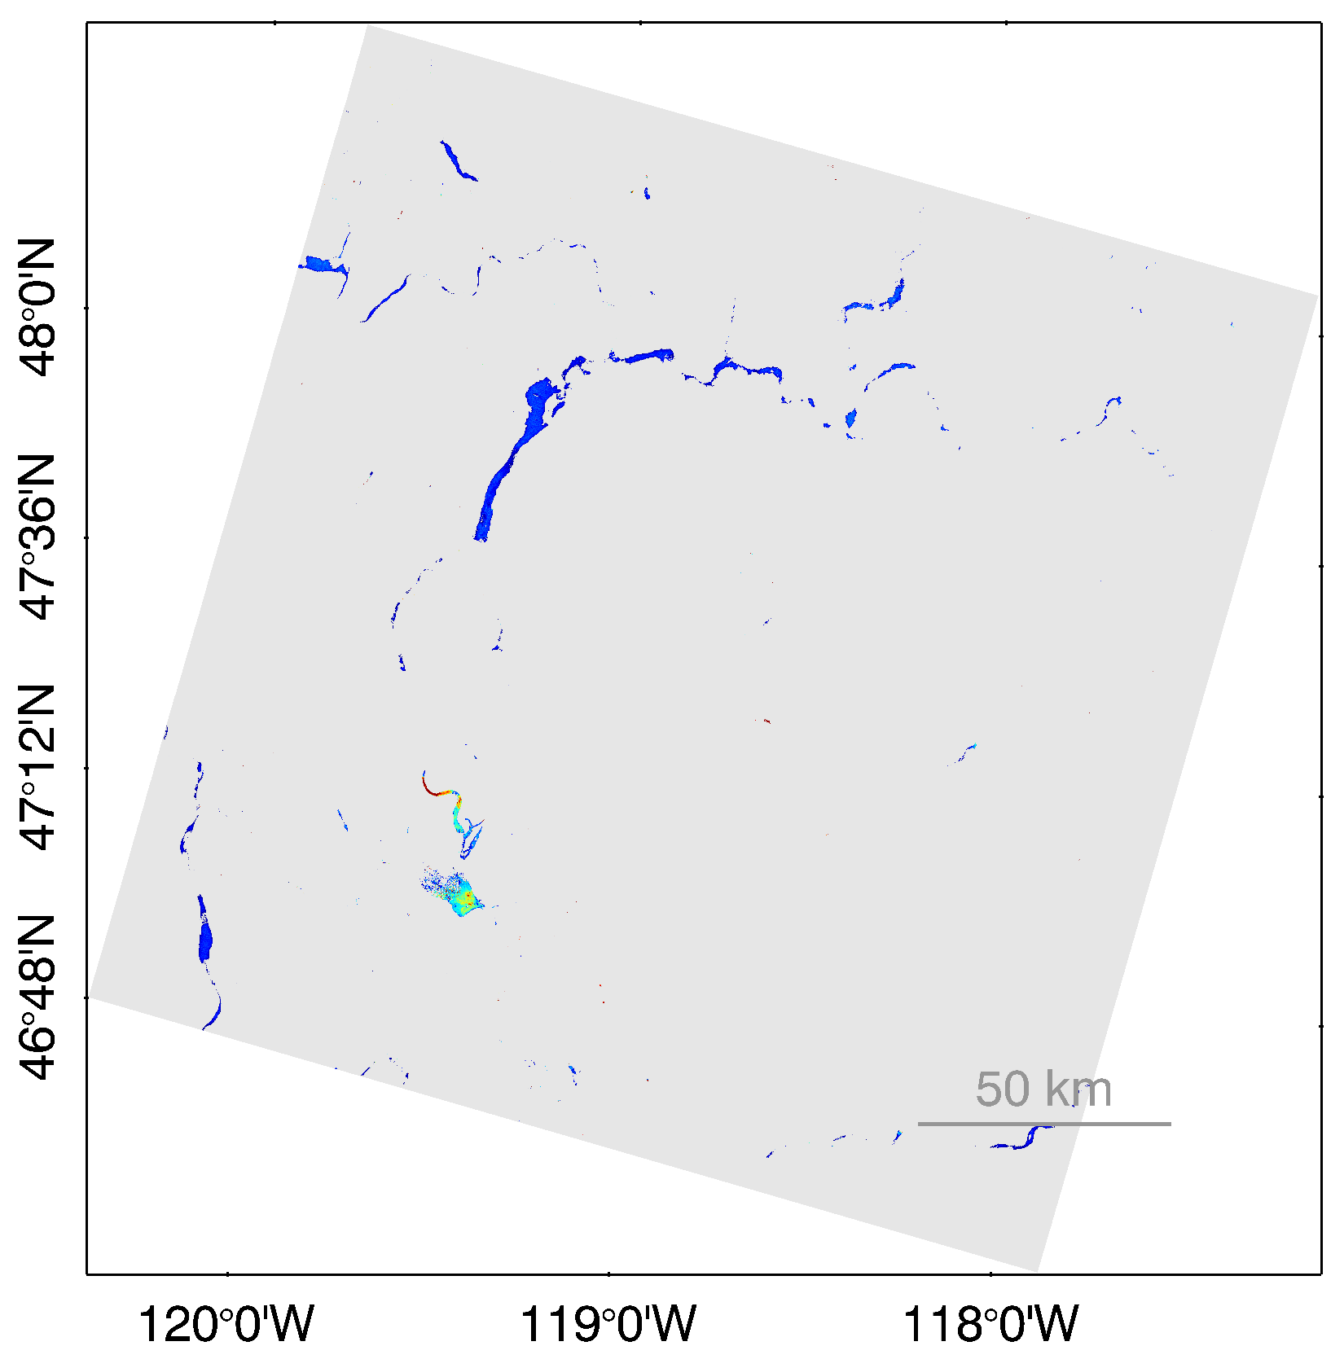
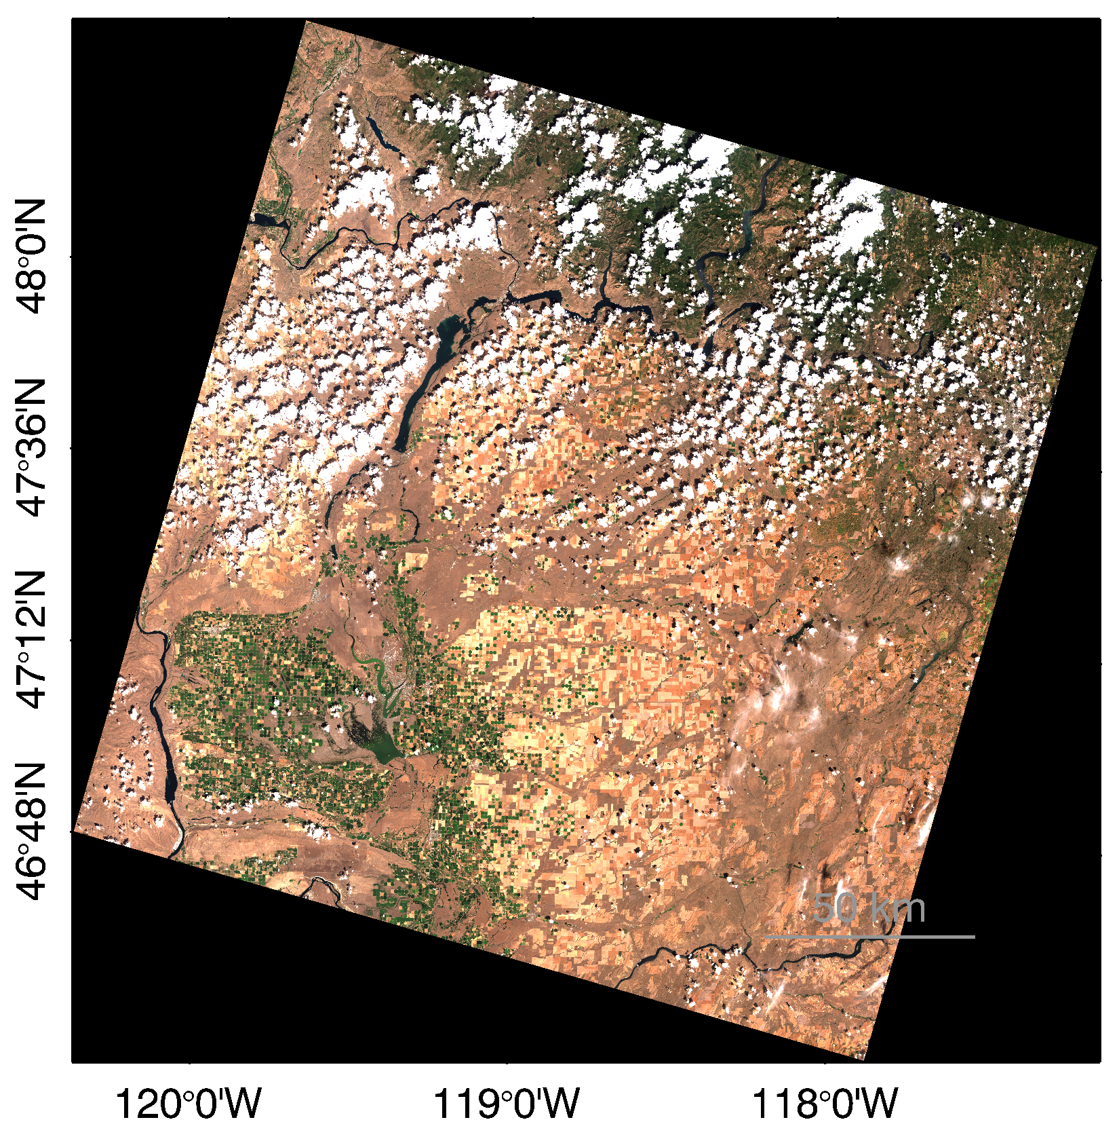
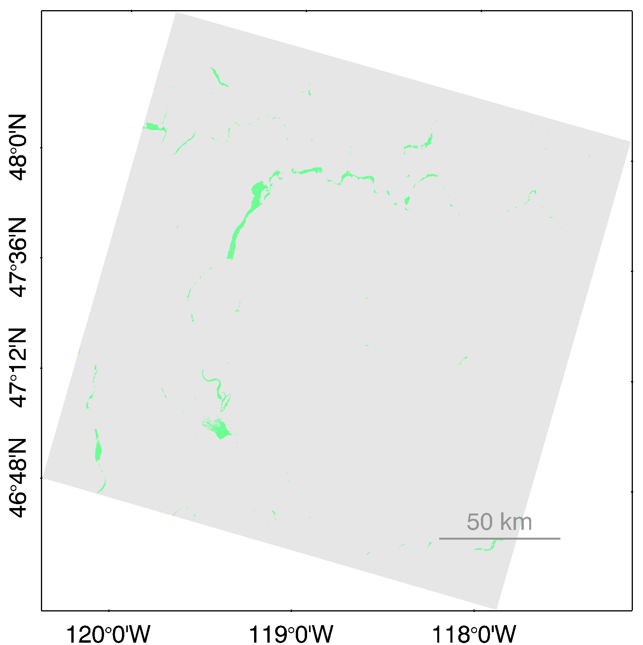
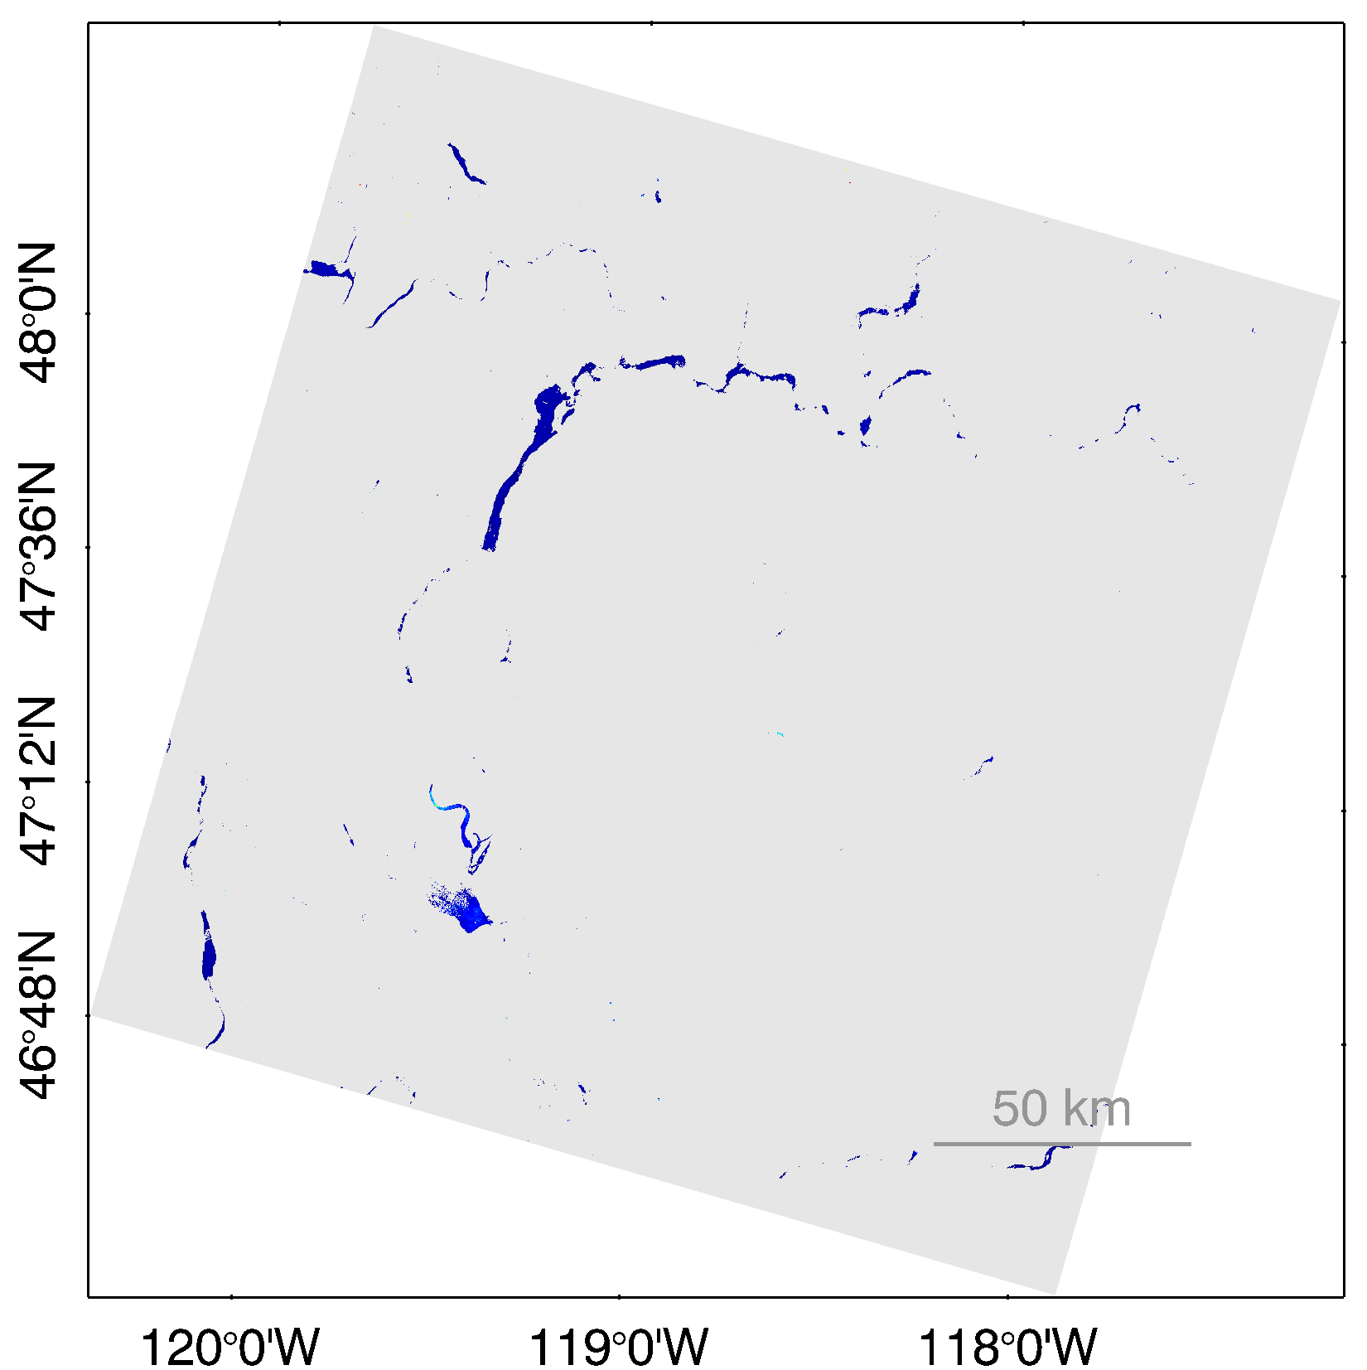
a
c
e
Landsat 8 OLI (a) top-of-the-atmosphere and (b) Rayleigh-corrected images for the Columbia River acquired on July 14th, 2016. The section of the tile that is the Columbia River north of Desert Aire is circled in red in (a). The large reservoir in the upper middle section of the image is Banks Lake, which is part of the Grande Coulee hydropower complex. Retrieved constituents includes (c) chlorophyll-a (mg/m3) using a blue-green band ratio algorithms (OC3), (d) a normalized chlorophyll-a index using the red and red edge bands (e) suspended particulate matter and (f) turbidity both derived using the near infrared.
d
f
b

